Slide 1
Preliminary Multiple Regression Analysis of Lake Superior Water Budget Components
Coordinating Committee Great Lakes Basic Hydraulic and Hydrologic Data
Buffalo, New York, USA, Nov. 5, 2014
Dave Holtschlag, USGS, and Vincent Fortin, EC

Slide 2
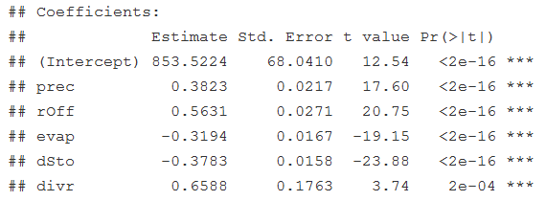

Multiple Regression for Predicting St. Marys River Flow

Slide 3
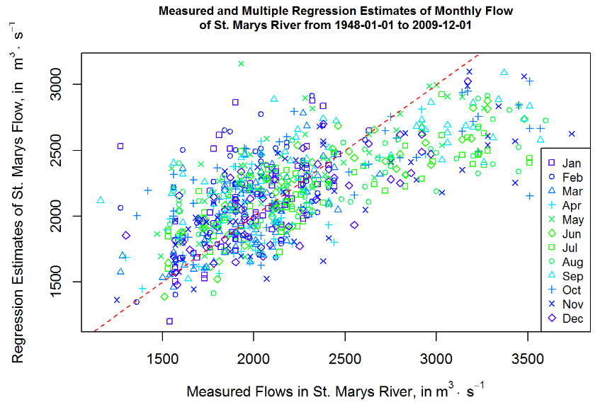
Prediction with Multiple Regression

Slide 4
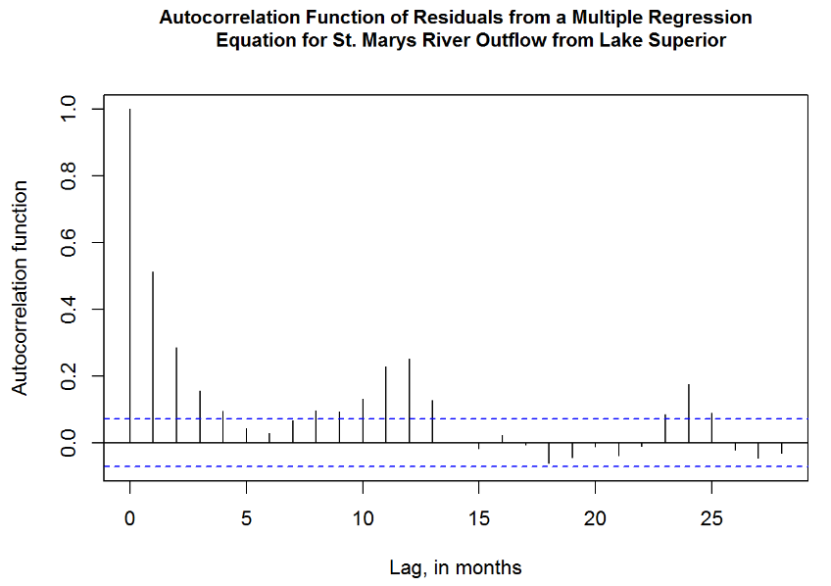
ACF of Multiple Regression Model

Slide 5
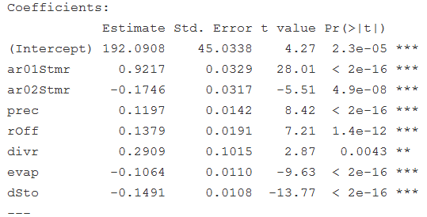
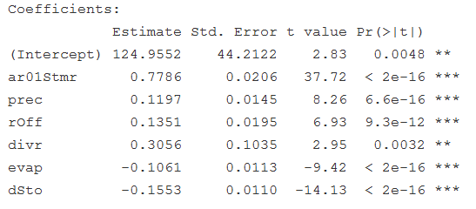


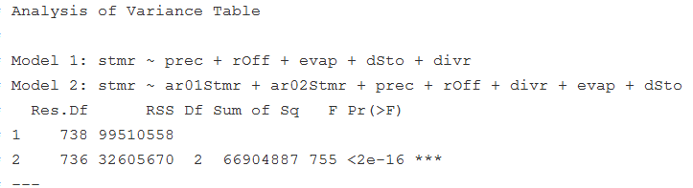
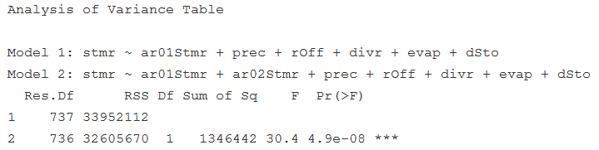
AR Multiple Regression Models

Slide 6
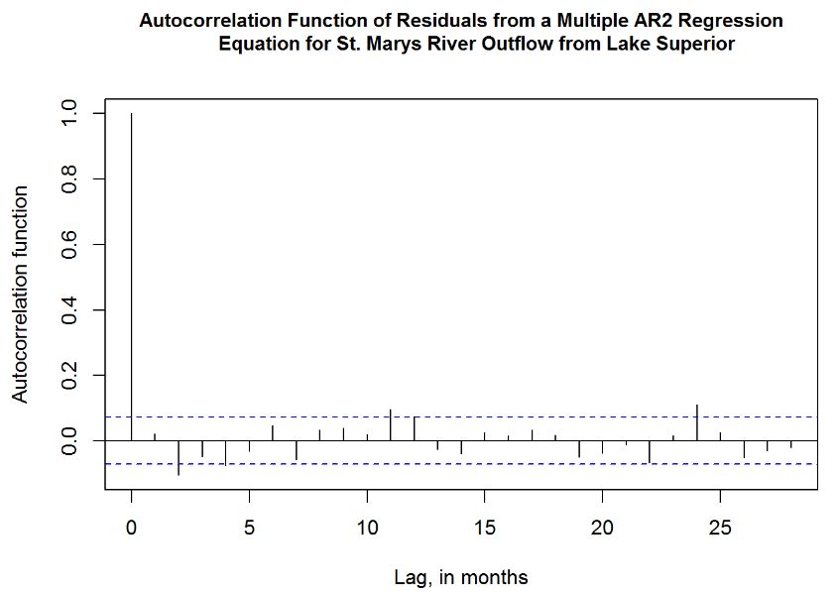
ACF of AR Multiple Regression Model

Slide 7
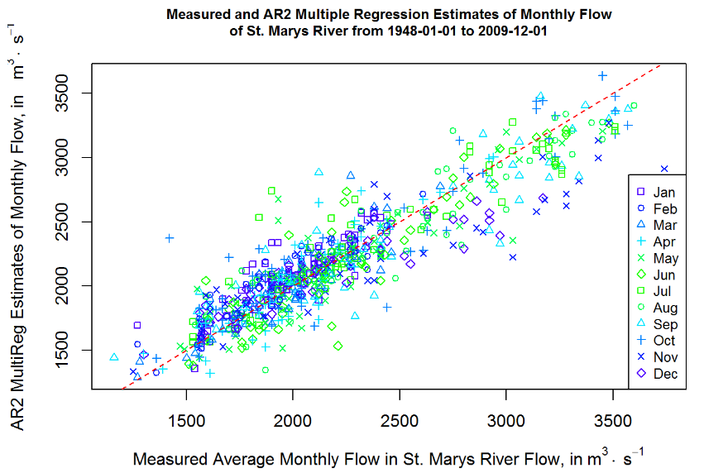
AR2 Multiple Regression Prediction

Slide 8
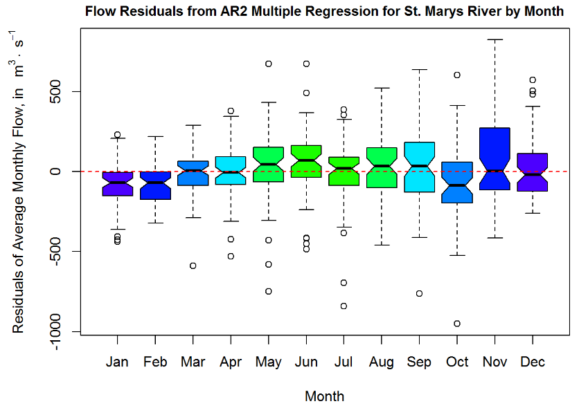
Distribution of Residuals by Month

Slide 9
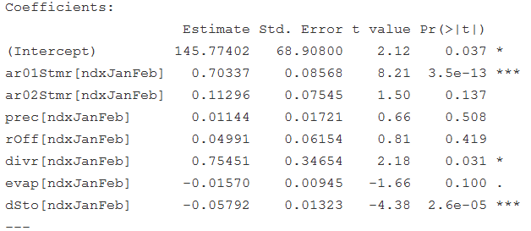
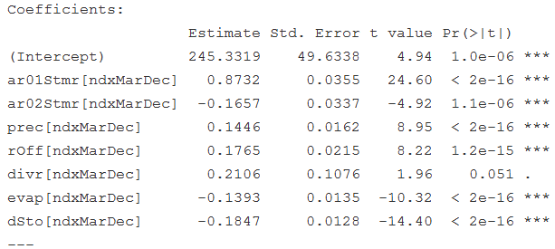


Seasonality: Jan-Feb and Mar-Dec

Slide 10
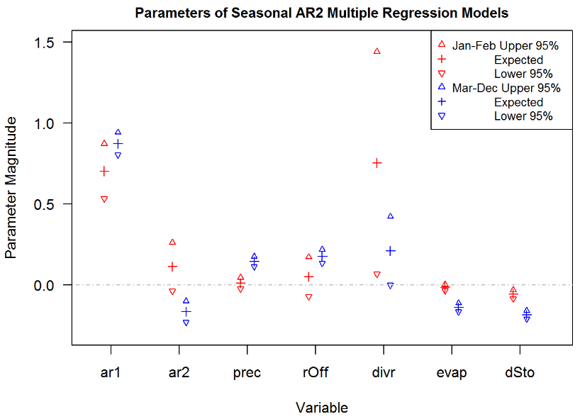
Seasonal Model Parameter Comparison

Slide 11
Preliminary Conclusions
Multiple Regression Model
Parameters signs are consistent with physical processes
Explains about 46.4 % of St. Marys Flow Variability
Under estimates higher flows over predicts lower flows
Autocorrelated Residuals
Autoregressive Model
Both AR₁ and AR₂ improve model prediction accuracy
Adj-R²: AR₁(0.817) and AR₂(0.824)
ANOVA(AR₁, AR₂) = 4.9x10⁻⁸
Seasonal Component in AR₂ Model
Jan-Feb Parameters differs from Mar-Dec Parameters

